Slide 1
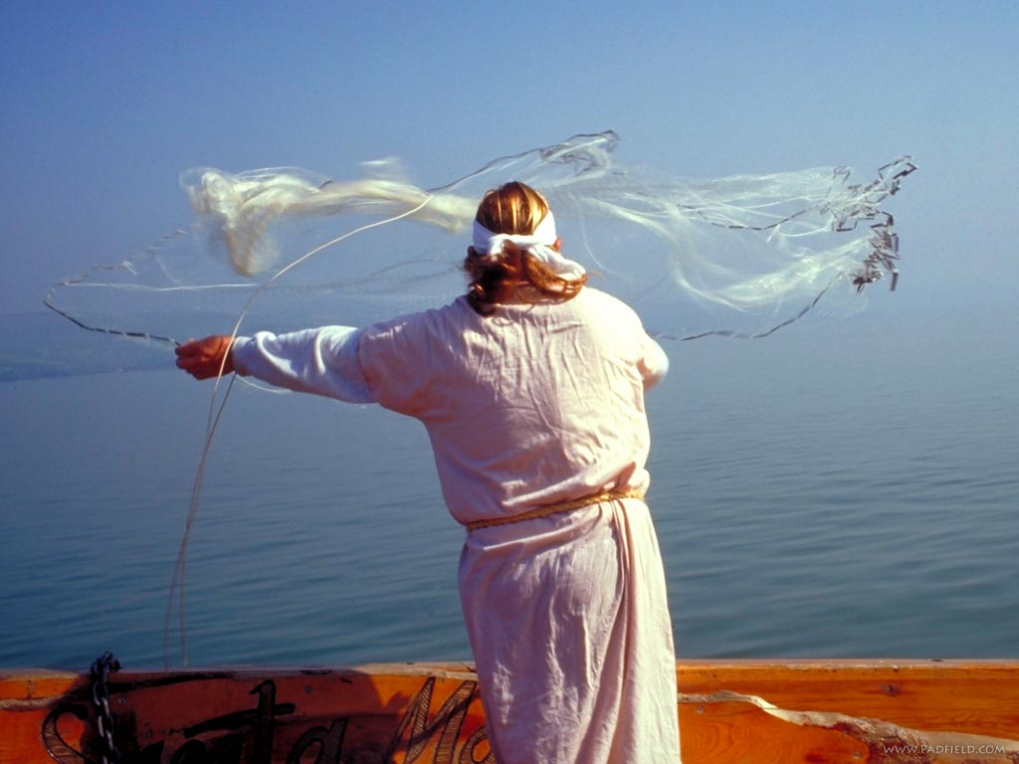
The church has left the building
New sermon series
at the
Sunset Avenue church of Christ

Slide 2


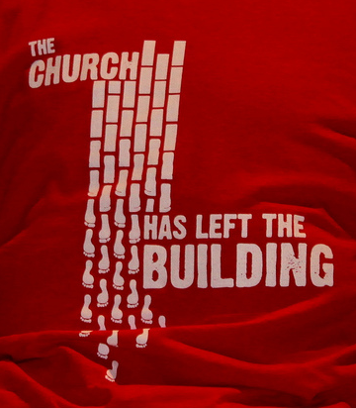
New Sunday morning
10:30 a.m. sermon series

Slide 3
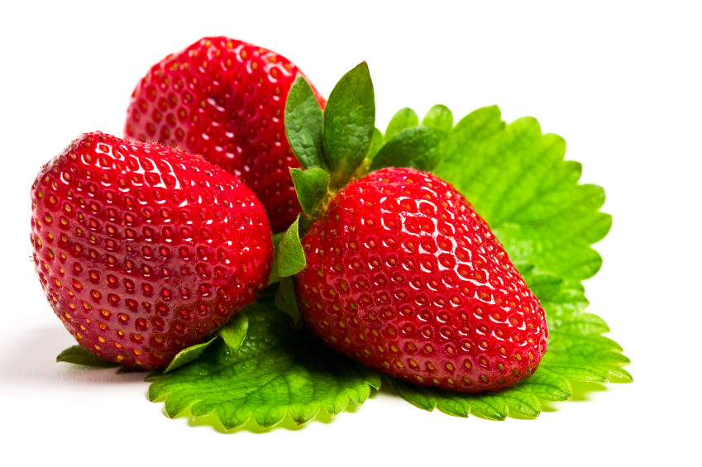
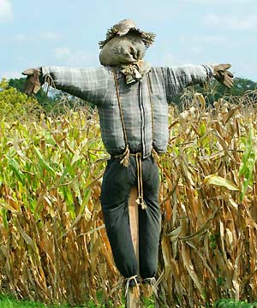
“Strawberries and Scarecrows”
The story of a man who walks along a country lane…
One of the best scarecrow stories you will ever hear
is taught by Jesus in
Matthew 25:14-30

Slide 4
“Strawberries and Scarecrows”
The story has three characters…two of them who immediately receive praise and admiration.
The third man is so different:
He made little or no effort, won no prize, and received no commendation. Instead, he lost what he had and was bound
and cast into outer darkness. It
would be difficult for Jesus
to find a more pathetic failure!

Slide 5
Harmless Scarecrows
1. The scarecrow of his own thoughts of littleness and insignificance.
Romans 12:3: Do not think of yourself more highly than you ought, but rather think of yourself with sober judgment, in accordance with
the measure of faith God has
given you.

Slide 6
Harmless Scarecrows
2. The scarecrow that kept him from the garden of plenty – unfavorable circumstances.

Slide 7
Harmless Scarecrows
3. The scarecrow was mistrust of His Lord.
We hear him say that his Master is a hard man (vs. 24). It’s another way of saying “Master, you’re not fair, you’re not just.”

Slide 8
Harmless Scarecrows
4. The fourth scarecrow: the possibility of failure.
Failure is one thing that can be achieved without effort. Failure is not stumbling
and falling. It's staying on the
floor. Failure should be our
teacher, not our undertaker.

Slide 9
They robbed him of usefulness. He ended up doing nothing because he was frozen by fear into total uselessness.
They robbed him of the joy of service to His Master and fellowman.
They robbed him of any growth through experience.
How did the scarecrows rob the man?

Slide 10
They robbed him of that which he did possess.
He lost his destiny.
How did the scarecrows rob the man?

Slide 11
1. Make use of them.
We have scarecrows in our own lives; what is to be done about our scarecrows?

Slide 12
1. Make use of them.
We have scarecrows in our own lives; what is to be done about our scarecrows?
2. Defy them. The scarecrow led the blackbirds to the strawberry patch! How foolish for them not to claim them.

Slide 13
1. Make use of them.
We have scarecrows in our own lives; what is to be done about our scarecrows?
2. Defy them. The scarecrow led the blackbirds to the strawberry patch! How foolish for them not to claim them.
3. Realize scarecrows are harmless!

